Slide 1
Application Development Orienting – Week 4
Loops Continued

Slide 2

Previously in ADO
Topics of last week
Void and typed methods
Parameters
Compound, prefix and postfix operators
For-loops

Slide 3

Content
Topics of this week
While-statement
Do…while-statement
Controls: ListBox & ComboBox
Learning objectives
Implement repetitive behaviour in your application
Understand the difference between a while and do…while statement
Use ListBox and ComboBox to display multiple pieces of information

Slide 4

Intro: while-statement
Thus far, we have seen one way of implementing repetitive behaviour: a for-statement
However, there are more repetition statements (loops)
while is one of them

Slide 5

Syntax
while (<condition>)
{
<statements>
//To exit the loop, the condition should
//evaluate to false at some point
}

Slide 6
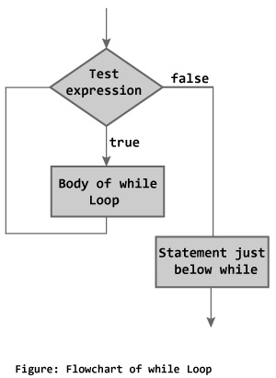
Semantics
The statement begins by evaluating the condition (a Boolean expression). If this is true, then execution proceeds by executing the loop-body.
Each time the loop-body is executed, the condition is evaluated again. If this is true, then execution proceeds as above.
If the condition evaluates to false, the while-statement is done.

Slide 7

Example
We would like to know what is the smallest power of 2 equal to or greater than a certain positive limit. The following method returns the required power of 2.
public int GetPowerOfTwo(int limit)
{
int powerOfTwo = 1;
while(powerOfTwo < limit)
{
powerOfTwo *= 2;
}
return powerOfTwo;
}

Slide 8

for vs while
Comparison between for and counter-controlled while
for(<counter_initialization>;
<continuation_condition>;
<action_after_each_iteration>)
{
<statements>;
}
<counter_initialization>;
while(<continuation_condition>)
{
<statements>;
<action_after_each_iteration>;
}
int sum = 0;
for(int counter = 0;
counter <= 10; counter++)
{
sum += counter;
}
int sum = 0, counter = 0;
while(counter <= 10)
{
sum += counter;
counter++;
}

Slide 9
Extra information
When constructing a while-statement, there are 4 parts that can be distinguished:
The code that should be executed as the loop-body
The boolean expression to represent the condition
The initialisation of the while-statement (what should be done before the loop)
The statements after the while-statement (what should be done after the loop)

Slide 10

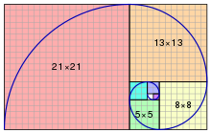
Your turn!
Create an app that calculates the smallest Fibonacci number bigger than a given value.
The Fibonacci sequence is given by:
F₀ = 0
F₁ = 1
F_{n} = F_{n-1} + F_{n-2}

Slide 11

Questions?

Slide 12
Intro: do…while-statement
There may be scenarios where the repeating code has to execute at least once
do…while-statement to achieve this

Slide 13
Syntax
do
{
<statements>;
//To exit the loop, the condition should
//evaluate to false at some point
} while (<condition>);

Slide 14
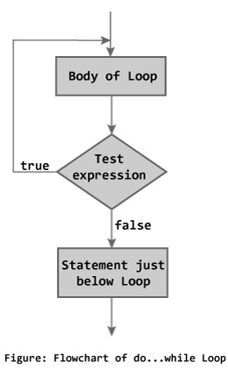
Semantics
The statement begins by executing the loop-body.
After the loop-body is executed, the condition is evaluated. If this is true, then the loop-body is executed again.
If the condition evaluates to false, the do..while-statement is done.

Slide 15
Examples
int sum = 0;
int counter = 0;
do
{
sum += counter;
counter++;
} while (counter <= 10);
//sum = 0 + 1 + … + 10;
//counter = 11;

Slide 16
Extra information
Comparison between while and do…while
int sum = 0;
counter = 12;
while (counter <= 10)
{
sum += counter;
counter++;
}
int sum = 0;
int counter = 12;
do
{
sum += counter;
counter++;
} while (counter <= 10);
sum = 0
sum = 12

Slide 17
Your turn!
Change your Fibonacci app to use a do…while loop instead of a while loop

Slide 18
Questions?

Slide 19
2

Slide 20
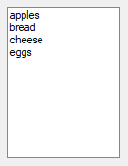
Intro: ListBox
What would be needed to display multiple pieces of information?
ListBox

Slide 21
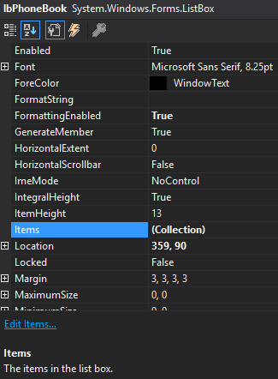
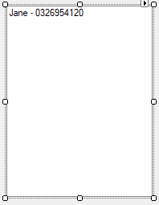
Syntax
Properties of ListBox
The ListBox displays each element in Items

Slide 22
Syntax (cont.)
You can also add an element to Items programmatically
You can remove all items from the ListBox
lbPhoneBook.Items.Add("Emily - 065884513");
lbPhoneBook.Items.Clear();

Slide 23
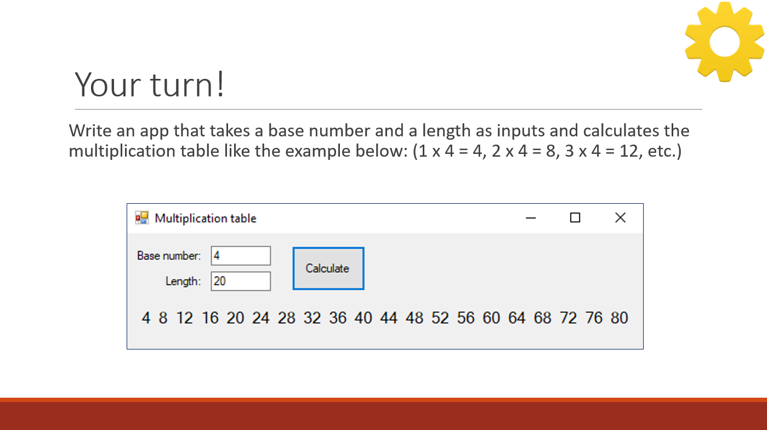
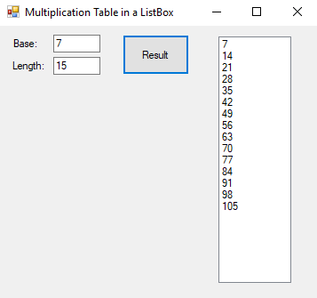
Your turn!
Remember last week’s app to display a multiplication table?
Now make one that displays it in a ListBox!

Slide 24
Questions?

Slide 25

Intro: ComboBox
What would be needed to display multiple options for a user to select?
Listbox
ComboBox

Slide 26
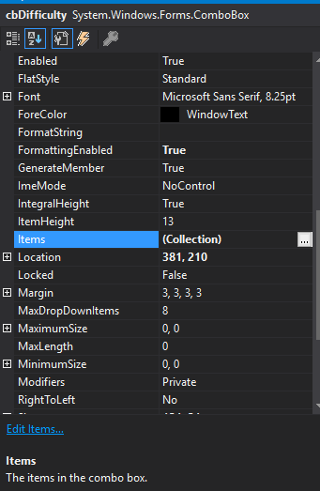
ComboBox
Properties of ComboBox
The set of elements shown in the ComboBox

Slide 27
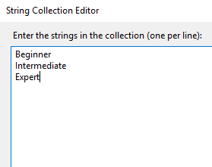
ComboBox (cont.)
Setting the options: click on the 3 dots (…) after (Collection)
The options to be displayed
The ComboBox

Slide 28
ComboBox (cont.)
A ComboBox can be seen as a combination of a TextBox and a ListBox
There are multiple ways to get the value:
cmbLevel.Text
cmbLevel.SelectedItem
These are not equivalent! What would be the difference?
cmbLevel

Slide 29
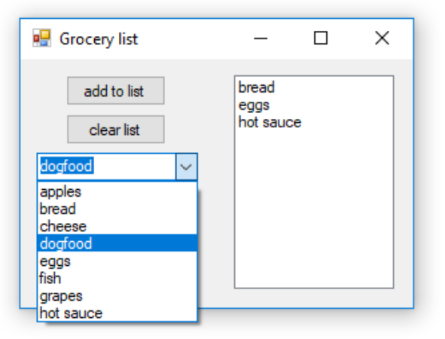
Your turn!
Write an app to add items to a grocery list.
Use a ComboBox for input
Display the grocery list in a ListBox

Slide 30
Questions?

Slide 31

FizzBuzz
1 2 Fizz 4 Buzz Fizz 7 8 Fizz Buzz 11 Fizz 13 14 FizzBuzz16 17 Fizz 19 Buzz Fizz 22 23 Fizz Buzz 26 Fizz 28 29 FizzBuzz31 32 Fizz 34 Buzz Fizz 37 38 Fizz Buzz 41 Fizz 43 44 FizzBuzz46 47 Fizz 49 Buzz Fizz 52 53 Fizz Buzz 56 Fizz 58 59 FizzBuzz61 62 Fizz 64 Buzz Fizz 67 68 Fizz Buzz 71 Fizz 73 74 FizzBuzz76 77 Fizz 79 Buzz Fizz 82 83 Fizz Buzz 86 Fizz 88 89 FizzBuzz91 92 Fizz 94 Buzz Fizz 97 98 Fizz
Notes:
Happiness, long life, family together

Slide 32

Test assignment: FIZZBUZZ
Write a program that prints the numbers 1 to 100.
But for multiples of three print "Fizz" instead of the number and for multiples of five print "Buzz".
For numbers which are multiples of both three and five print "FizzBuzz".
Upload to Canvas before the deadline!

Slide 33

Summary
While-statement to implement repetition
Do…while-statement to implement repetition that executed at least once
Use ListBox and ComboBox to handle multiple pieces of information

Slide 34

What to do next?
Hand in your test assignment!
Assignments week 4

